Slide 1
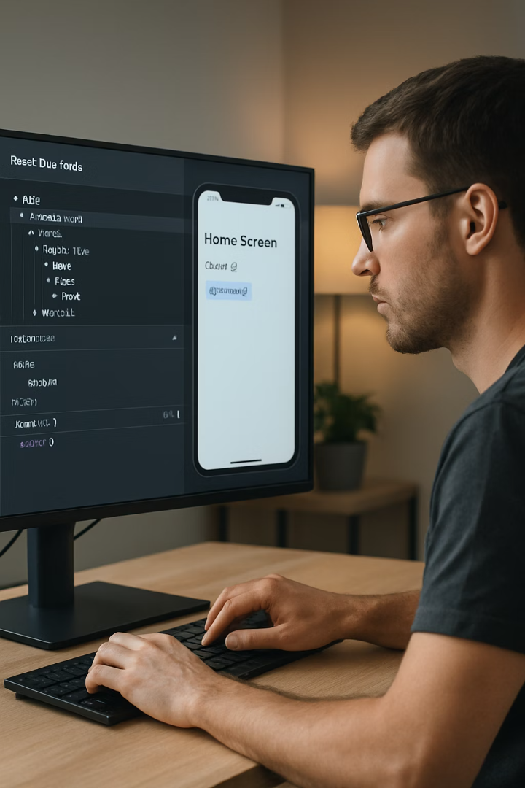
React DevTools: Essential Debugging for React Native Developers
Master the art of debugging and optimizing your React Native applications with React DevTools. This powerful browser extension will transform how you develop, test, and refine your code.

Slide 2


What You'll Learn
1
Component Tree Navigation
Explore your app's structure with intuitive visualization tools.
2
Real-time Editing
Modify props and state without reloading your app.
3
Context API Integration
Learn to debug shared state across components.
4
Performance Profiling
Identify and fix bottlenecks in rendering.

Slide 3
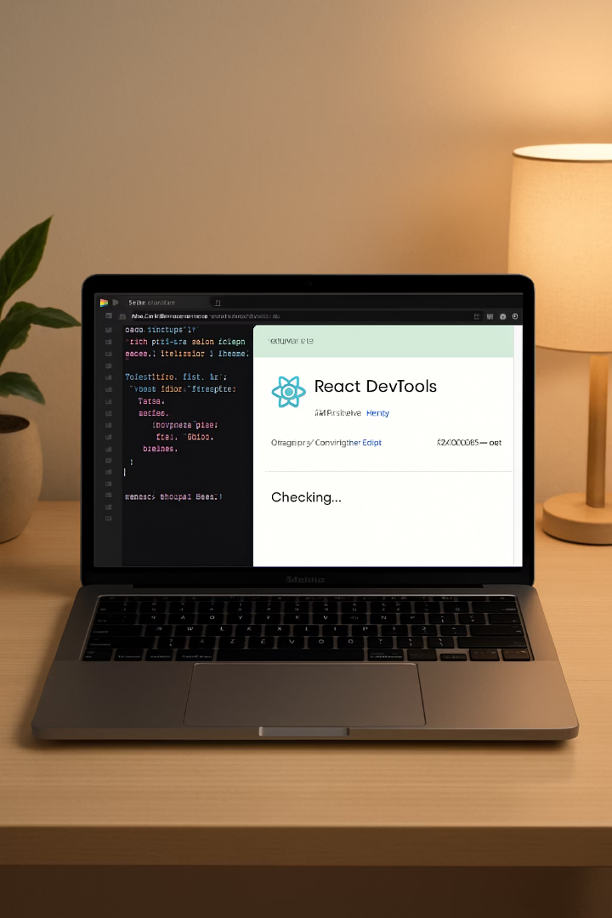
Getting Started
Install Browser Extension
Add React DevTools to Chrome, Firefox, or Edge from the extension store.
Connect to React Native
Configure your development environment with the correct ports.
Verify Connection
Check that DevTools shows your component hierarchy.

Slide 4








The Component Tree
Find Components
Inspect Properties
Locate specific components using the search functionality.
View props, state, and hooks for any selected component.
See Updates
Edit Values
Watch how changes propagate through your component tree.
Modify props and state to test different scenarios instantly.

Slide 5
Inspecting Components
Component Selection
Props Examination
State Analysis
Click any component in the tree to inspect it. The panel updates with all relevant data.
View all props passed to the component. Props appear in an expandable tree format.
Examine current state values. State updates trigger highlights in the DevTools.
You can also select components directly from your app's UI using the picker tool.
Complex objects can be fully expanded to examine nested properties.
Track how state changes affect your component's behavior in real time.

Slide 6
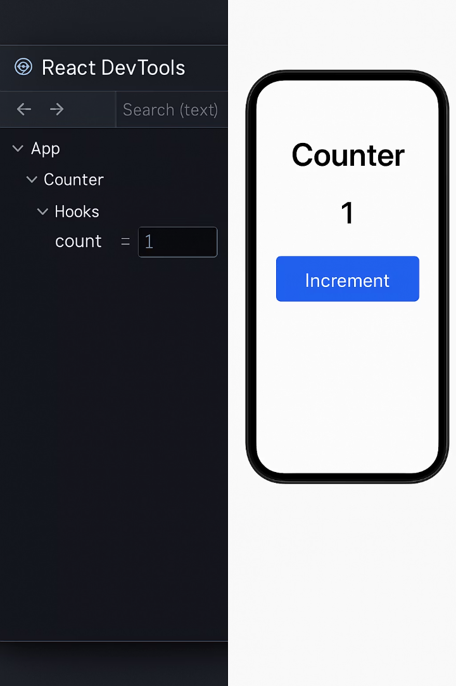
Real-time Editing
Modify Props
Update State
Double-click any prop value to edit it. Changes appear instantly in your app.
Edit state values directly. Watch how state changes trigger re-renders.
Experiment with different values without changing code.
Reset to original values with a single click.
Test Edge Cases
Simulate error conditions by modifying props. Test empty strings or null values.
Verify that your components handle unexpected inputs gracefully.

Slide 7



Debugging Context
Find Context Providers
Locate all Context providers in your app
Inspect Context Values
View all data in the context
Modify Context Data
Test how changes affect consumers
React DevTools displays Context providers as special components in the tree. You can inspect and modify Context values just like props and state.

Slide 8
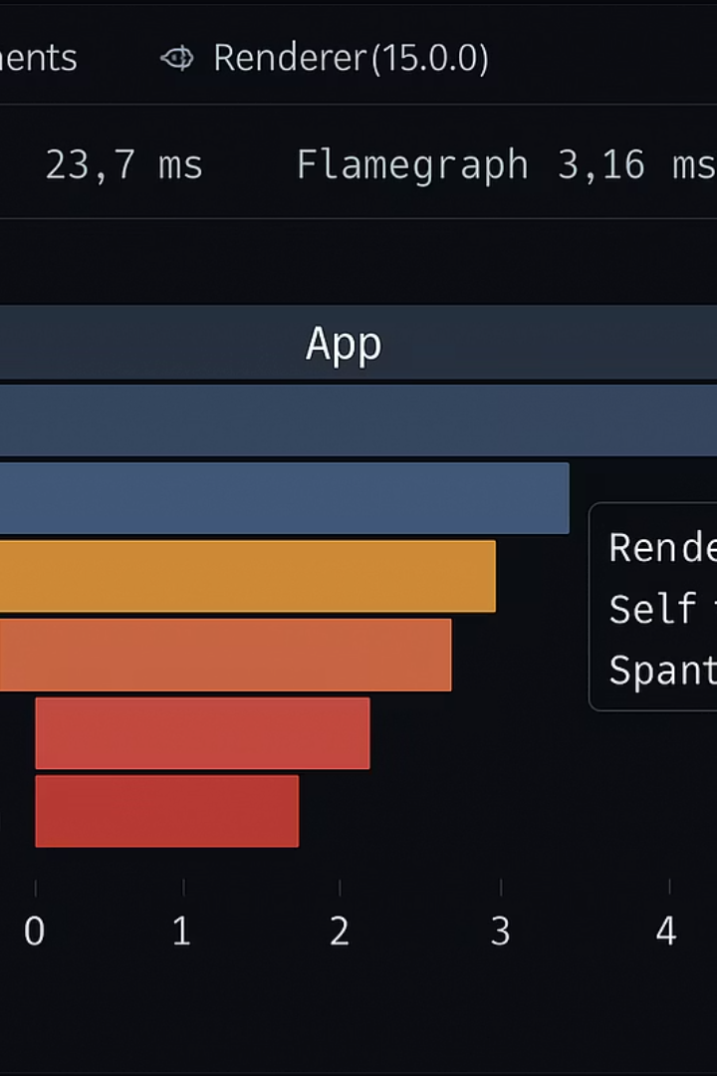




Performance Profiling
Record a Session
Capture component rendering activity during user interactions.
Analyze Render Times
Identify components that take too long to render.
Spot Re-render Issues
Find components that render unnecessarily.
Implement Optimizations
Apply memoization techniques where beneficial.

Slide 9
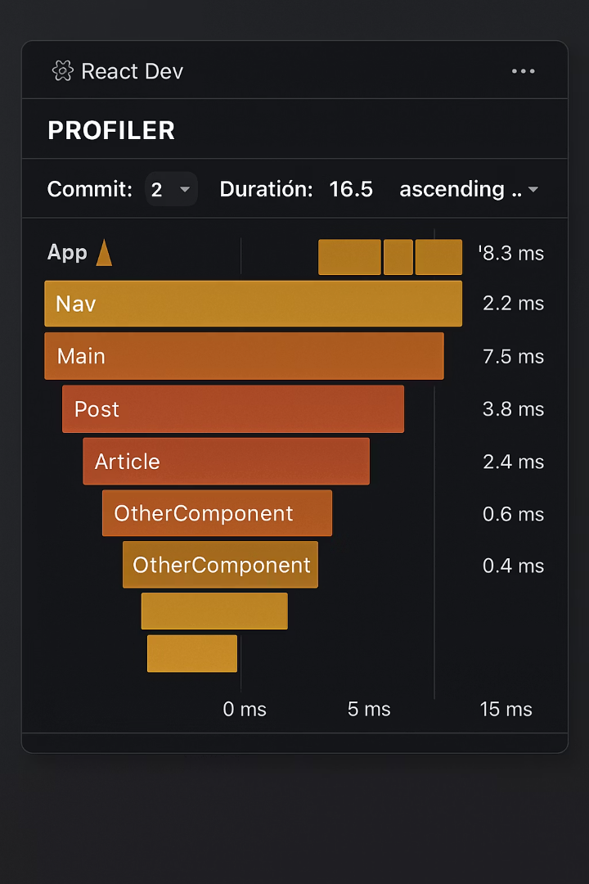
The Profiler Tab
Timing Visualization
Color-coded flame charts show render durations at a glance.
Commit Browser
Navigate between different rendering "commits" to compare performance.
Ranked Chart
See components sorted by render time to quickly identify bottlenecks.
Interaction Tracking
Measure time between user action and screen update.

Slide 10

Common Performance Issues
Issue
Symptom
Solution
Excessive Re-renders
Components updating when data hasn't changed
Use React.memo() or shouldComponentUpdate
Expensive Calculations
Slow render times on specific components
Apply useMemo() to cache results
Callback Recreation
New function references on every render
Implement useCallback() for event handlers

Slide 11
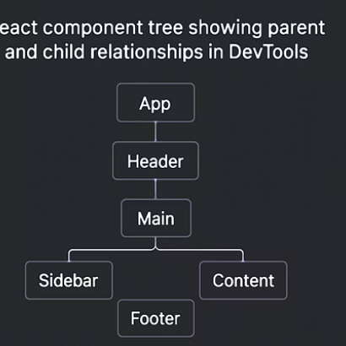
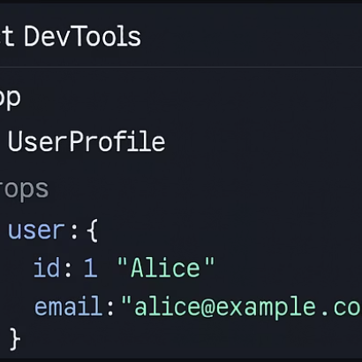
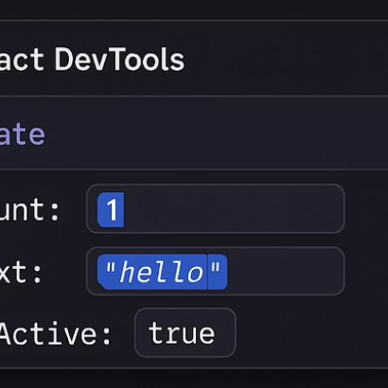
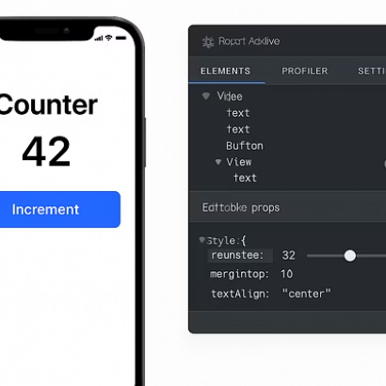
Hands-on Example
Let's examine a small application structure. We'll see how data flows from parent to child components and how DevTools helps visualize this relationship.

Slide 12

Advanced Techniques
1
2
Component Filtering
Component Search
Use regex patterns like "/^List/" to isolate component families or filter by render count to find over-rendering components
Press Ctrl+F to quickly locate components by name, prop value, or even hook usage patterns across deeply nested structures
3
4
Break on Changes
Save/Load Profiles
Set JavaScript breakpoints when specific props or state change to pinpoint exact moments when React Native UI behaves unexpectedly
Export performance profiles as JSON files to share bottlenecks with your team or compare metrics before and after optimization attempts

Slide 13
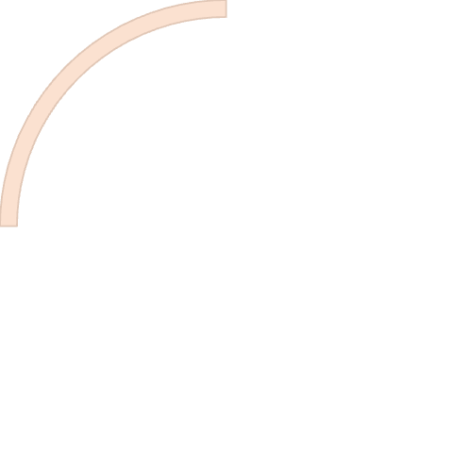
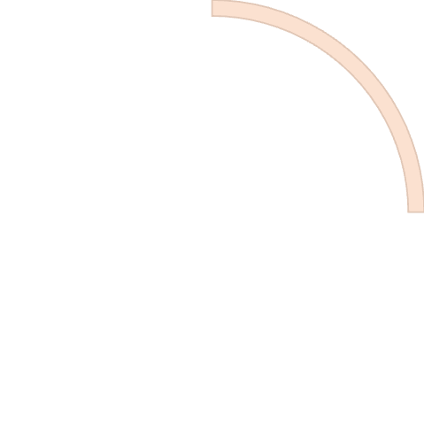






Keyboard Shortcuts
Navigation
Up/Down: Move between components
Finding
Ctrl+F: Search components
Left/Right: Collapse/expand components
Ctrl+G: Find next match
Shift+Ctrl+G: Find previous match
Home/End: Jump to first/last component
Settings
Editing
Ctrl+/: Toggle filter
Enter: Edit selected value
Ctrl+Shift+D: Toggle dock position
Escape: Cancel editing
Ctrl+Shift+T: Toggle themes
Ctrl+Enter: Submit multiline edit

Slide 14
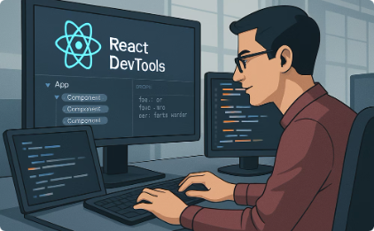

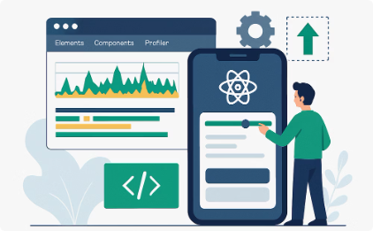
Next Steps
Daily Practice
Incorporate DevTools into your regular development workflow. Start with simple inspections and gradually add profiling.
Team Knowledge Sharing
Teach your colleagues these techniques. Share performance profiles to solve problems together.
Optimization Projects
Take an existing app and use DevTools to identify and fix performance bottlenecks.

Slide 15
Key Takeaways: Mastering React DevTools
Visualization Power
Real-time Debugging
Explore component hierarchies and data flow patterns to quickly identify structural issues in your React Native applications.
Inspect and modify component props, state, and context without code changes, significantly accelerating your debugging workflow.
Performance Optimization
Daily Practice
Identify render bottlenecks using the Profiler tab and implement targeted optimizations like useMemo() and useCallback() to improve app responsiveness.
Incorporate these tools into your development routine, share knowledge with teammates, and systematically approach optimization projects for maximum impact.
Remember: Effective debugging isn't just about fixing errors—it's about understanding your application's behavior at a fundamental level.

